Slide 1
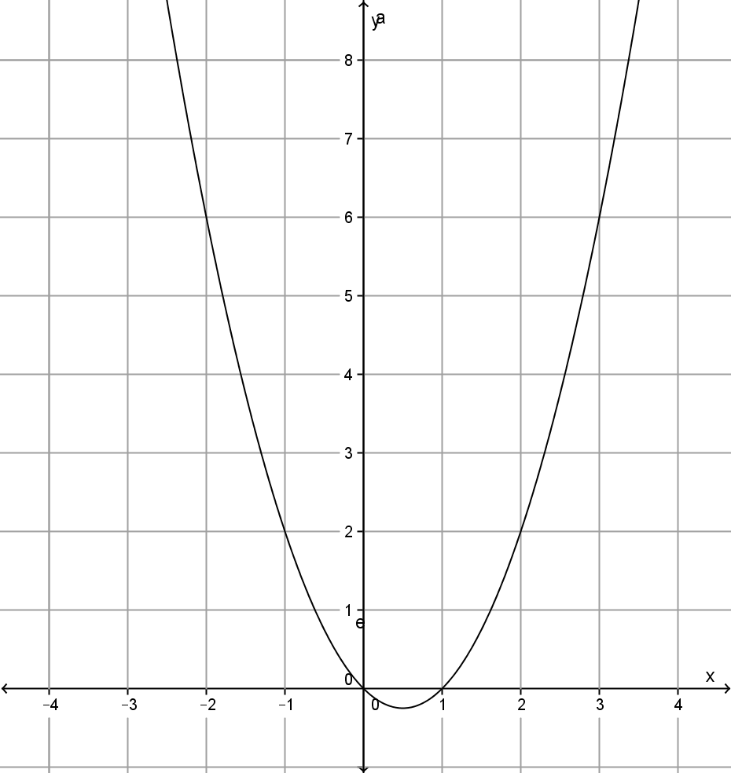
My Non-linear Relationship Interactive Notebook
Name
Class
Mrs Rust
Term 4 Semester 2
1

Slide 2
Create your own front page
It needs to contain the following –
My Non-Linear Relationships interactive notebook
Name
Class
Teachers Name
Semester 2 Term 4
Page number 1

Slide 3
Contents
Glossary or Formula Page
Page
Date
Description
2
3

Slide 4
Tasks
24
7
30
Essential Question
Questions
Notes
Summary
4
5

Slide 5
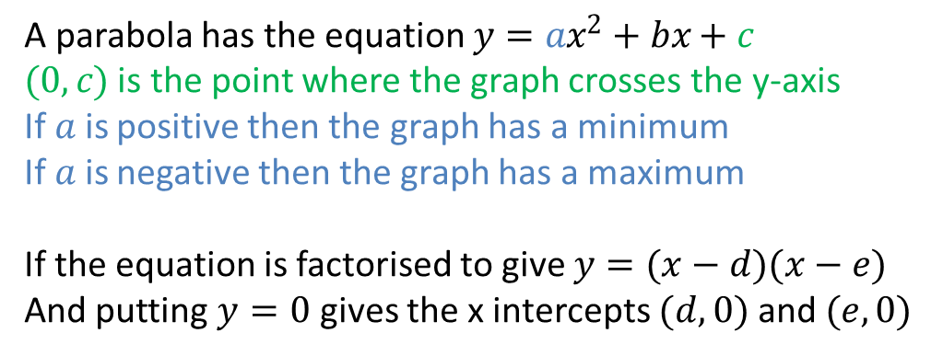
24
7
30
Date
Properties of parabolas and circles
EQ – Describe how to sketch a parabola or a circle given the equation.
A parabola has the equation $y=ax^{2}+bx+c$
$(0,c)$ is the point where the graph crosses the y-axis
If $a$ is positive then the graph has a minimum
If $a$ is negative then the graph has a maximum
If the equation is factorised to give $y=(x−d)(x−e)$
And putting $y=0$ gives the x intercepts $(d,0)$and$(e,0)$
9

Slide 6
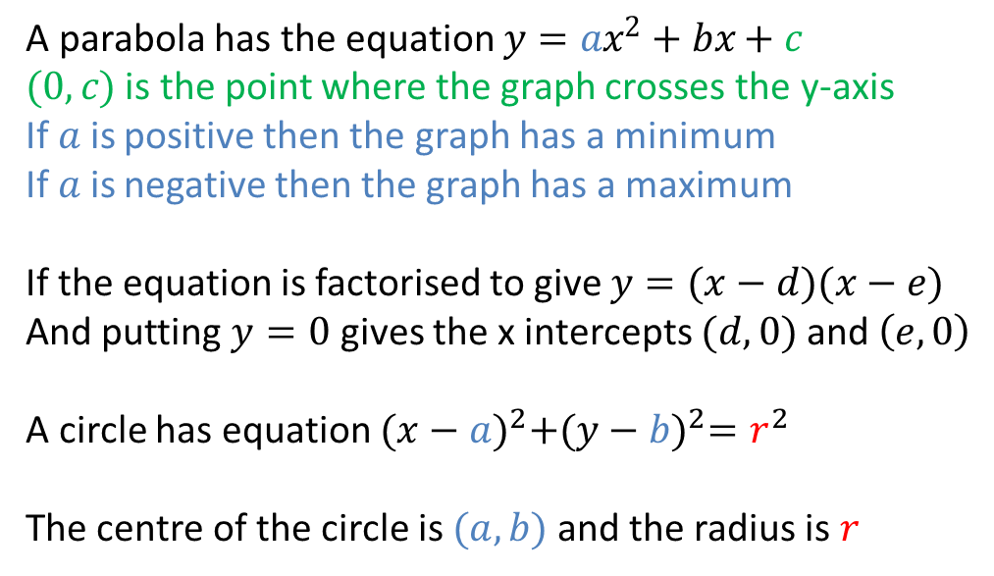
24
7
30
Date
Properties of parabolas and circles
EQ – Describe how to sketch a parabola or a circle given the equation.
A parabola has the equation $y=ax^{2}+bx+c$
$(0,c)$ is the point where the graph crosses the y-axis
If $a$ is positive then the graph has a minimum
If $a$ is negative then the graph has a maximum
If the equation is factorised to give $y=(x−d)(x−e)$
And putting $y=0$ gives the x intercepts $(d,0)$and$\left(e,0\right)$
A circle has equation ${(x−a)}^{2}+{(y−b)}^{2}=r^{2}$
The centre of the circle is $(a,b)$and the radius is $r$
9

Slide 8
Notes Review
24, 7 ,30
Date
Title
Essential question
Notes complete
Notes complete with colour and diagrams
Questions completed
Contents page filed in
Formula page filled in

Slide 9
Homework
Review your notes and write a summary answering the essential question.

